Slide 1
IST687 Final Project
Team 003
Gina Clark
Yea Rin Kim
Shayan Orellana
Andrew Dobkowski
Elizabeth Westbrook

Slide 2

Introduction
Group 3 decided to analyze streaming service data found on Kaggle, as it seemed fruitful, as the host of variables seemed ripe for analyzing.
The data contains such variables as movie title, release year, movie ratings from IMDb and Rotten Tomatoes, whether a movie is being hosted on any of four streaming platforms (Netflix, Hulu, Prime Video and Disney+), movie genres, languages in which the film is available, and total runtime.
Our initial (simple) business questions were developed early in the process. We eventually each selected a business question to answer. In most cases, our initial business question led us to develop more interesting, advanced, and useful questions.

Slide 3
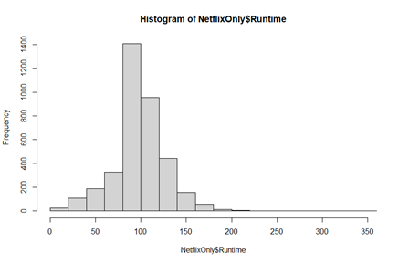
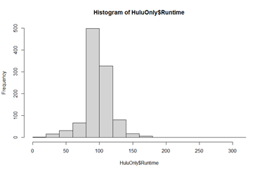
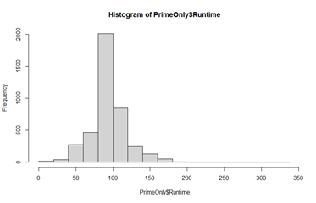
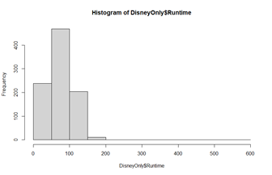
Business Question #1
Question 1: What platforms have the longest runtimes, and can we make any business interpretations from our results?
Platforms: Netflix, Hulu, Amazon Prime, & Disney+

Slide 4
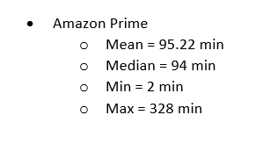
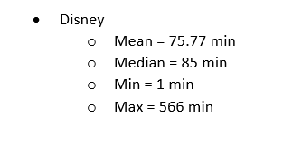
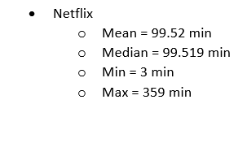
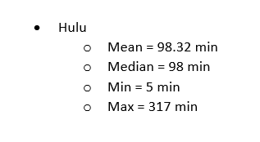
Business Question #1
There is a clear difference between the runtimes of Disney+ and the other platforms. The difference is the target audience. Disney’s audience is primarily children with shorter attention spans than adults. Therefore, it makes complete sense that Disney will have a lot lower runtimes than their competitors.

Slide 5
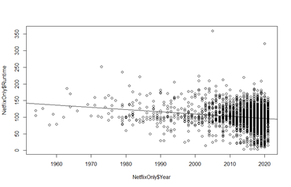
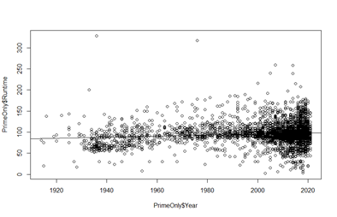
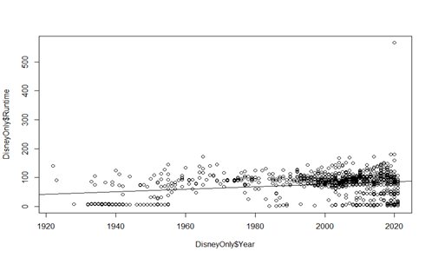
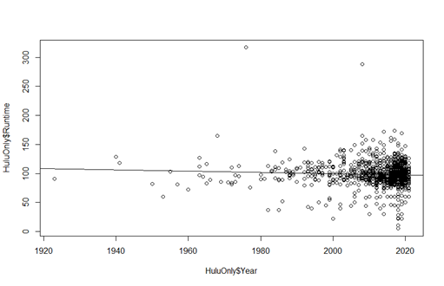
Business Question #1
Have movies been getting longer or shorter as we move forward?
The linear models clearly illustrate that all platforms are trying to keep their movies under 100 minutes and all trendlines point towards around 90 minutes moving forward.

Slide 6
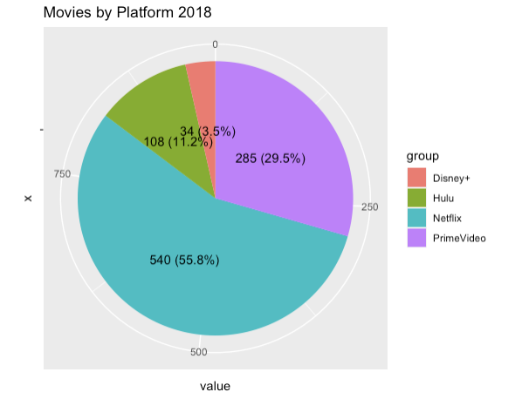
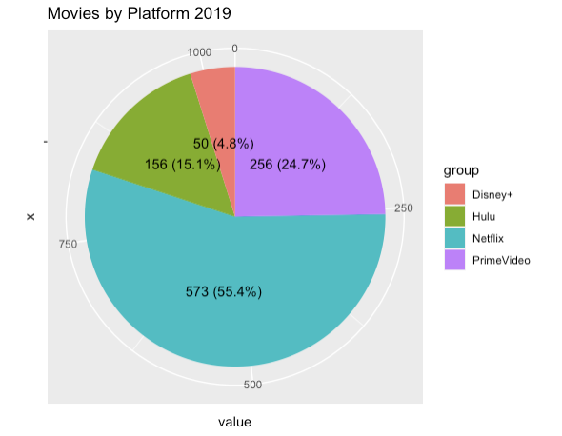
Business Question #2
Which streaming service had the most movies from 2018 to 2021? What can you tell about market share from the result?
Netflix had the largest share of movies released in 2018 and 2019.
Amazon Prime, having 256 of movies, had the second largest (29.5%) of shares.
Hulu and Disney had 11.2% and 3.5% respectively.

Slide 7
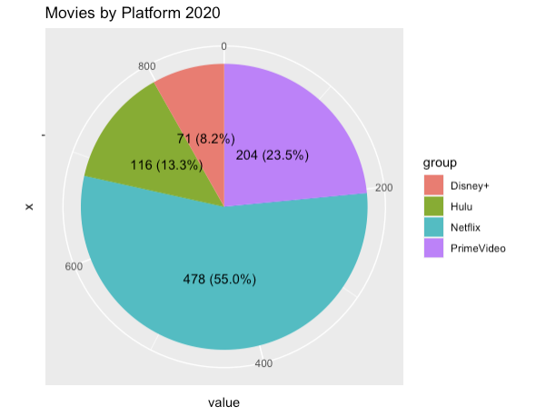

Business Question #2
Despite the pandemic in 2020, film industry had a strong growth in general producing just as many films as the previous year.
Disney and Hulu gradually expanding shares in the market

Slide 8
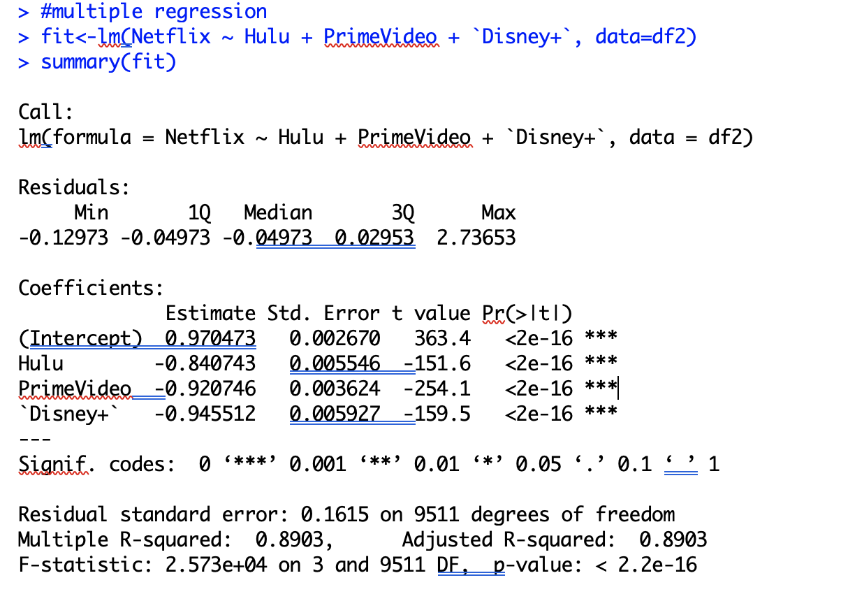
Business Question #2
Relationship between different streaming services:
89% Model Accuracy from Adjusted R-Squared
All Explanatory(independent) Variables' P-value < 0.01 which shows the model is significant at 1% level

Slide 9
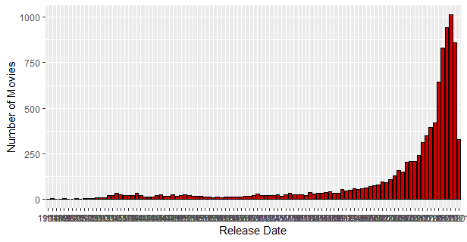
Business Question #3
Question 3: Which year had the greatest number of movies released that are featured on the streaming services? Did the COVID-19 pandemic influence production?
A quick look at the data totaling count of movies by year revealed that movie release years featured on the streaming services spanned from 1914-2021.

Slide 10
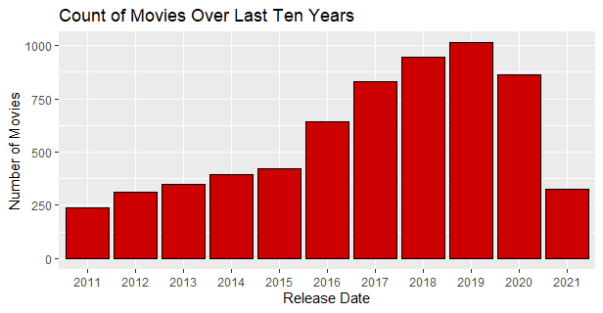
Business Question #3
Narrowed the scope to look at the last ten years of releases
Although we can't confirm that the pandemic is the cause, there is a downward trend in movies produced after 2019.

Slide 11
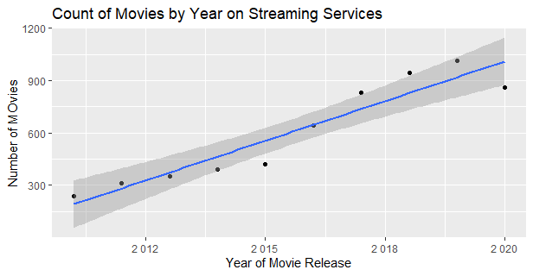
Business Question #3
How many movies would be predicted to be featured with release dates in 2021 assuming more will be produced this year and more will be added to the streaming services?
The prediction model estimated the number of movies to be 1,010 to be featured with release dates in the year 2021. Currently, that number is 327, which is a deficit of 683 movies. The lower limit of the prediction is 874, which still leaves another 547 movies to be added to the streaming services with a 2021 release year if our prediction is to be accurate, unless there is another attribute affecting movie production.

Slide 12
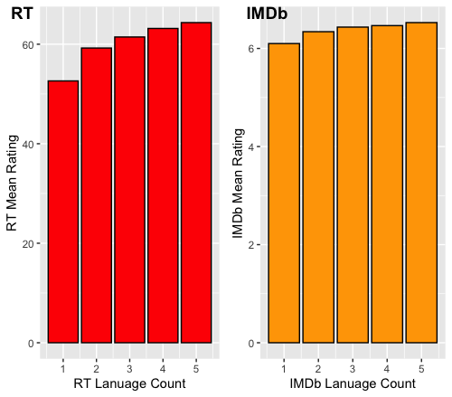
Business Question #4
Does an increasing number of languages available for a particular movie indicate a higher aggregate rating?
At first glance, it seems as though we have a positive correlation between the language count and mean ratings for both Rotten Tomatoes and IMDb.

Slide 13
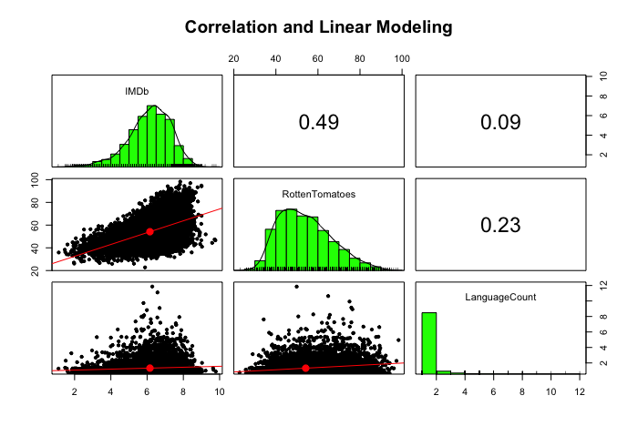
Business Question #4
The correlation coefficient for both IMDb and Rotten Tomatoes were both below values of 0.25. According to Pearson's and Spearman's coefficient, these values are considered to indicate an absence of correlation.

Slide 14
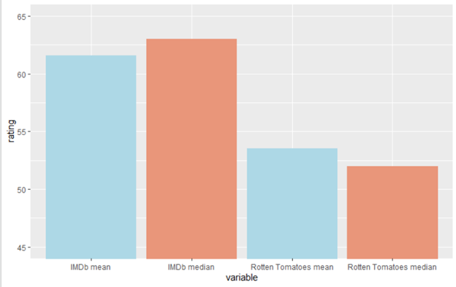
Business Question #5
Which ratings platform averages higher ratings?

Slide 15
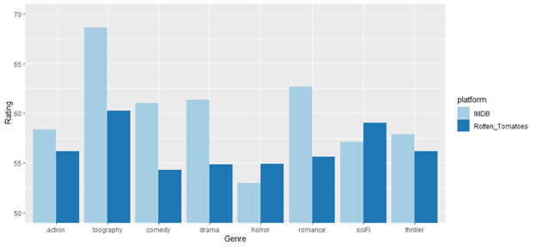
Business Question #5
Do IMBD users consistently rate all genres of movies higher than Rotten Tomatoes critics?

Slide 16
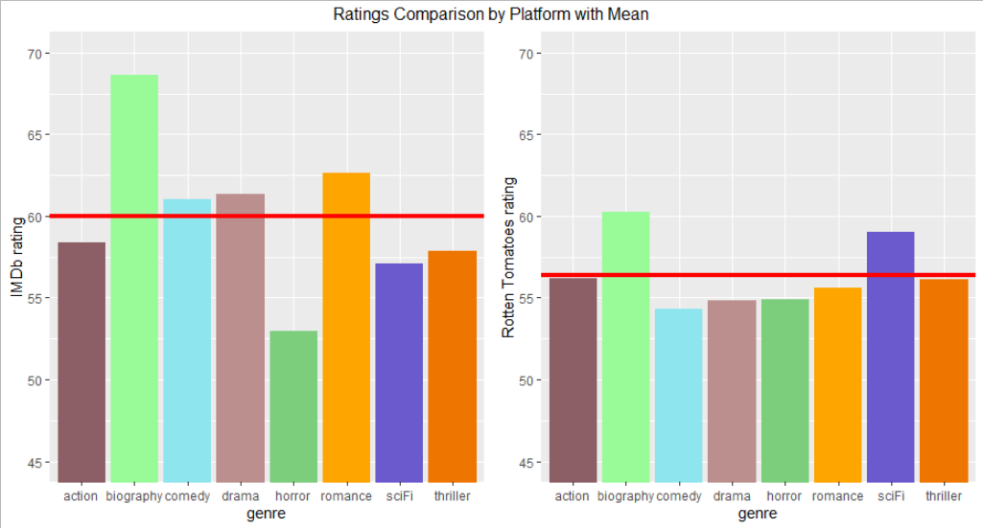
Business Question #5
Which platform is more consistent in its ratings?
mean(ratings2$IMDB)
[1] 59.99281
sd(ratings2$IMDB)
[1] 4.623158
mean(ratings2$Rotten_Tomatoes)
[1] 56.40997
sd(ratings2$Rotten_Tomatoes)
[1] 2.113434

